Slide 1

Android: Supporting Different Devices
LEIM – DAM

Slide 2
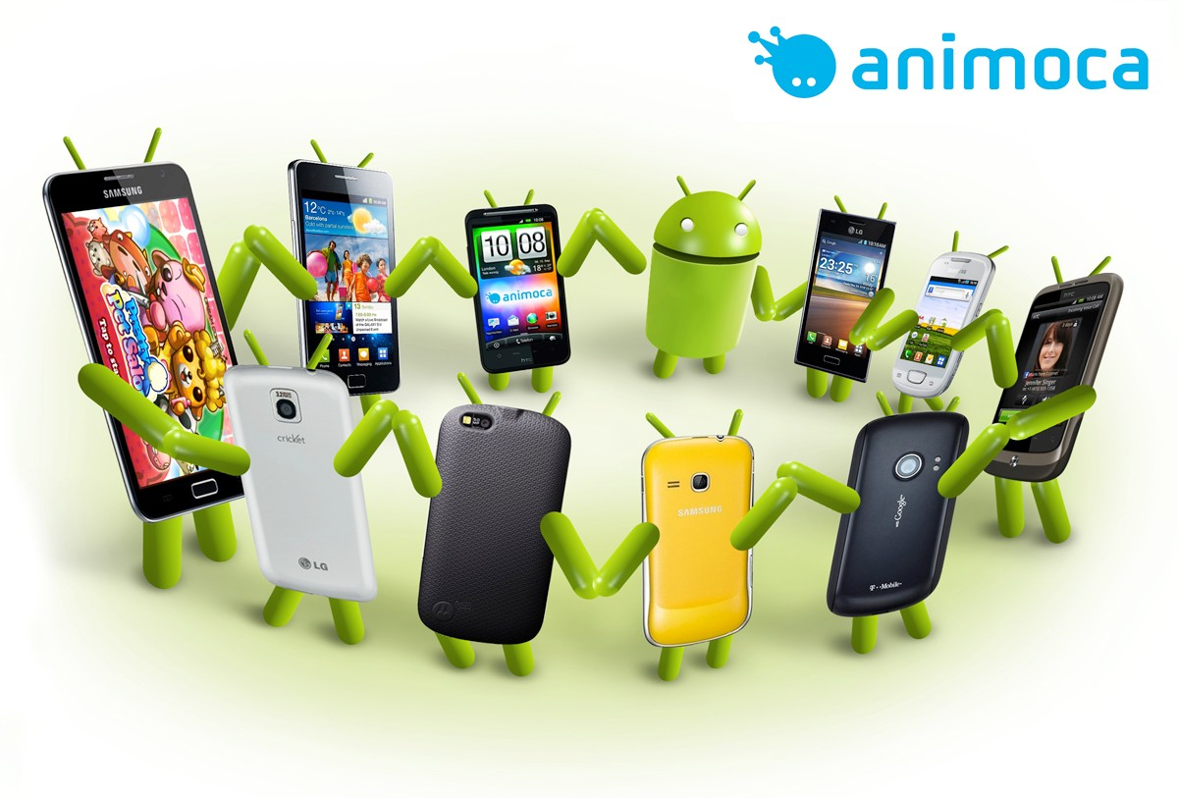
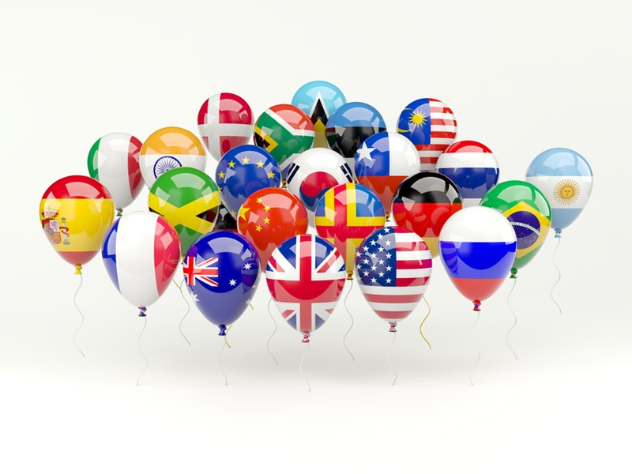
Android app in different devices and for different cultures
Android system is designed to be used on millions of smartphones, tablets and other devices for with a wide variety of screens and for user of any language and culture
Different Languages and Cultures, Different Screens, Different Platform Versions

Slide 3
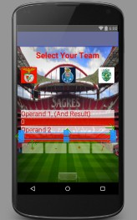
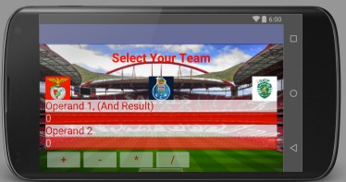
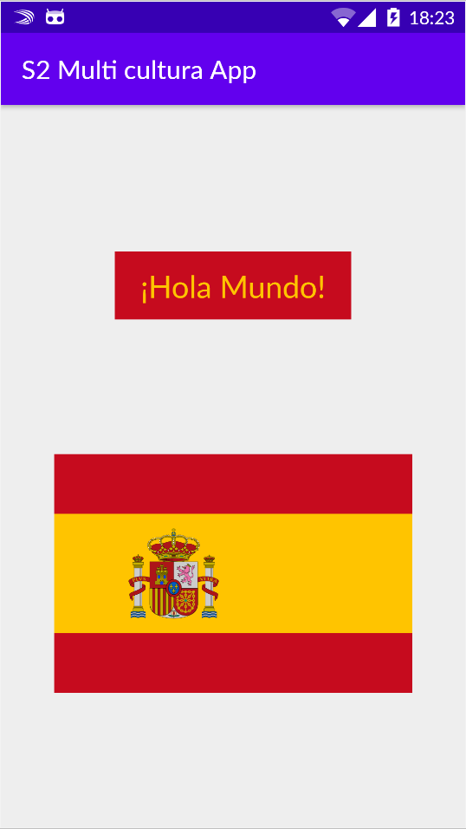
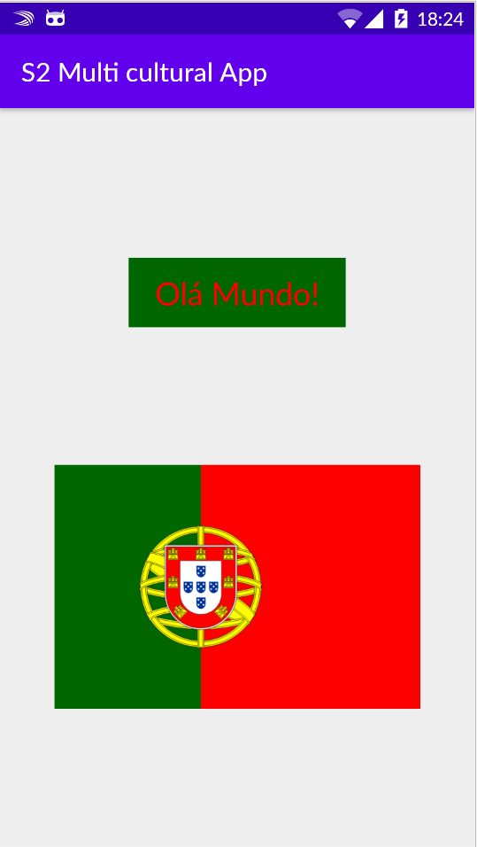
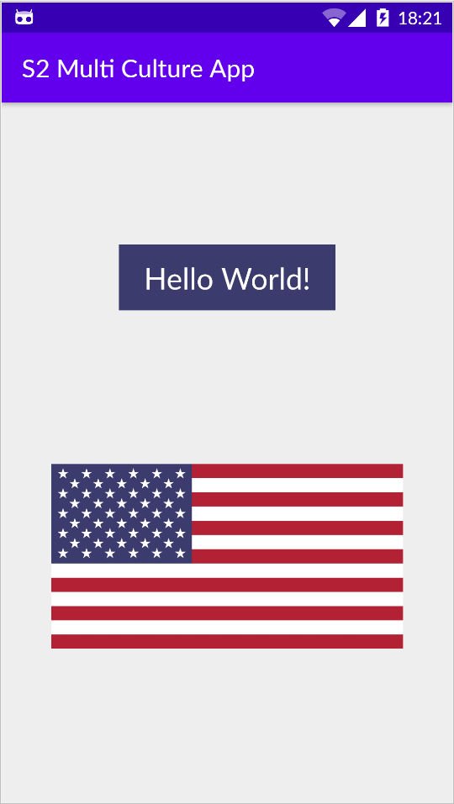
Alternative resources

Slide 4
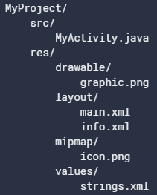
Alternative resources
Resources placed in res/ directory
Grouped in directories
Animator, anim, color *, drawable, mipmap, layout, menu, raw, values, xml, font
* for color state list resources, like colours in different button states
Described in XML files
Inside values directory we may have: arrays.xml, colors.xml, dimens.xml, strings.xml , tyles.xml
Alternative resources
Alternative resources provide a way to have appropriate resources in distinct cases
In distinct cultures (different language, images, sounds, …)
In distinct devices (different sizes, densities, …)
https://developer.android.com/guide/topics/resources/providing-resources#AlternativeResources

Slide 5
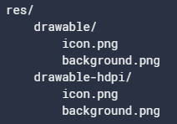
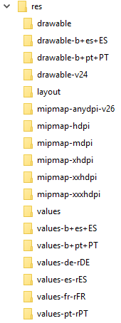
Alternative resources
Place for Alternative resources in directories
<resources_name>-<config_qualifier>
Resource_name: Animator, anim, color *, drawable, mipmap, layout, menu, raw, values, xml, font
Type of Config_qualifier (for values see link below):
mobile country code, language and region, layout Direction, smallestWidth, Available width, Available height, screen size, Screen aspect, Round screen, Wide Color Gamut, High Dynamic Range (HDR), Screen orientation, UI mode, Night mode, Screen pixel density (dpi), Touchscreen type, Keyboard availability, Primary text input method, Navigation key availability, Primary non-touch navigation method, Platform Version (API level)
https://developer.android.com/guide/topics/resources/providing-resources#AlternativeResources

Slide 6

Different cultures

Slide 7



Different Languages
Idea: play country anthem
Build a multi-culture app: an app that can be used by users with different languages and cultures
Different language, but also different images, colors, sounds, …
Flags extracted from wikipedia

Slide 8
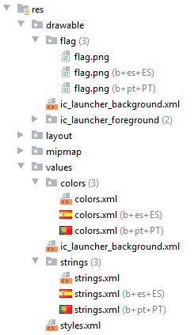
Build a multi-culture app
In code use a reference to a resource (with a identifier)
Not use strings/colors/images/… directly in code
Put resources and their identifiers in separate files
“res/values/strings” is the default file for en_US language
Use other files for other languages (placed inside /res folder):
Files should have the same name (as original) but be placed in a directory that tells the system which culture to use:
<resource type>-b+<language code>[+<country code>] or
<resource type>-<language code>[-r<country code>]
Image on right shows Android view (Project Tool window) for previous app (different images, colors and Strings)
but files are in diferent directories – use Project view to see all files (and create folders)
The android system gets the resources depending on language activated in the device

Slide 9
Alternative resources - languages
Alternative way to name alternative resource directories
<resource type>-b+<language code>[+<country code>] or
<resource type>-<language code>[-r<country code>]
We can use both ways – the Android Studio uses the second way
The second way is the original Android way
The first way were introduced in Android 7, and uses a Best Pratice from the IEFT (see link below)
https://tools.ietf.org/html/bcp47 (BCP – Best current pratice) 47 Tags for Identifying Languages
In Android we can also use: <resource type>-<language code>[-r<country code>]

Slide 10
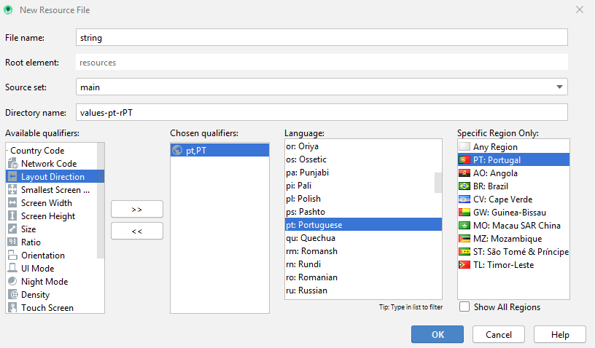
Create a Language resource file
Manually: create the directory; create the Strings.xml file
Wizard: over res/ select with the mouse: New -> Android resource File. On New Resource File window select the Language item and Language Settings, as in the figure

Slide 11
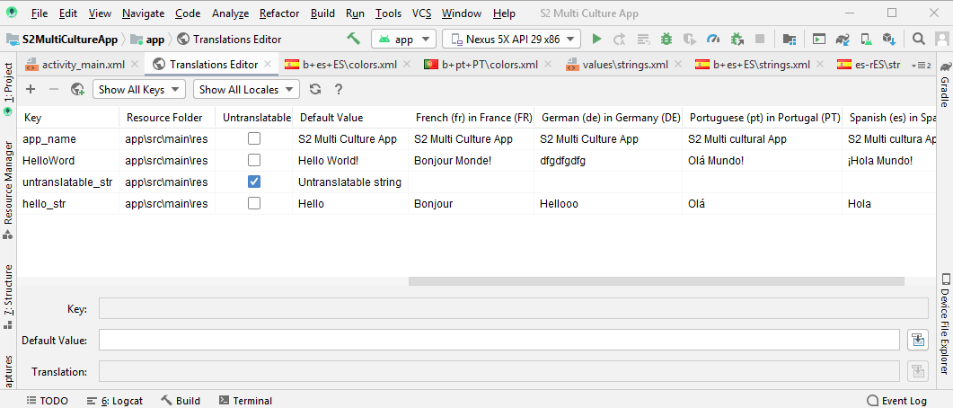
Create and manage Language resource files
Use the Translations Editor:
over string with the mouse select “Open Translations Editor“
Here you can add/delete a Language file and a string item
This editor uses the Android nomenclature, ex: values-pt-rPT

Slide 12
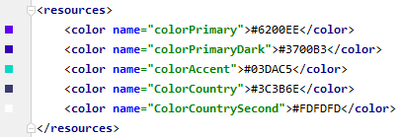
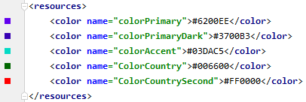
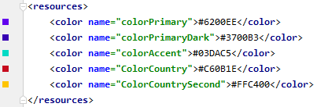
strings.xml and colors.xml files for each Language
English: res/values/strings.xml
Português: res/values-b+pt+PT/strings.xml
Spanish: res/values-b+es+ES/strings.xml
colors.xml
<resources>
<string name="app_name">S2 Multi Culture App</string>
<string name="HelloWord">Hello World!</string>
</resources>
<resources>
<string name="app_name">S2 Multi cultural App</string>
<string name="HelloWord">Olá Mundo!</string>
</resources>
<resources>
<string name="app_name">S2 Multi cultura App</string>
<string name="HelloWord">¡Hola Mundo!</string>
</resources>
<TextView android:text="@string/HelloWord" android:textColor="@color/ColorCountrySecond"
android:background="@color/ColorCountry" . . . />
<ImageView app:srcCompat="@drawable/flag" . . . />
Use in layout resource

Slide 13
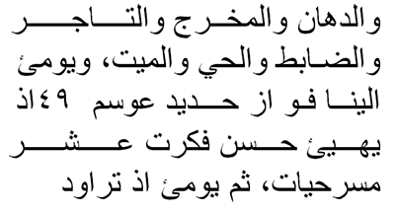
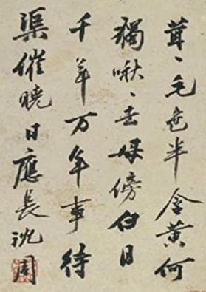
Support for multiple languages and cultures
Languages may use:
in right-to-left (RTL) text for Arabic or Hebraic: layout-ldrtl
instead of left-to-right (LTR) text - default
Layout Direction of: ldrtl or ldltr
in vertical columns which were read from top to bottom and right-to-left like in traditionally Chinese writings

Slide 14
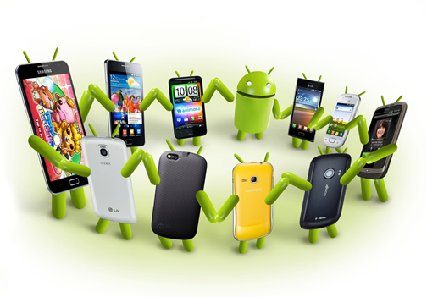
Different devices

Slide 15
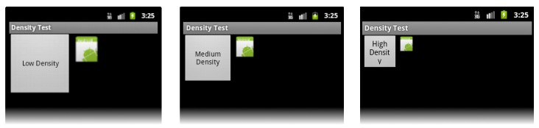
Different Devices
Problems:
Distorted images
Buttons, icons, and text too small or too large
Layouts adapted to small screens but not for large ones
How to develop applications to handle multiple devices?
https://developer.android.com/guide/practices/screens_support

Slide 16
How to Support Multiple Screens?
Provide different layouts for different screen sizes
Ex: layout-xlarge/
Provide different images for different screen densities
Ex: drawable-hdpi/

Slide 17
Features
Orientation
Display dimensions
Display density
Resolution
Density-independent pixel (dp)
Scale-independent pixel (sp)

Slide 18
Orientation
Screen Orientation
Portrait
Landscape

Slide 19
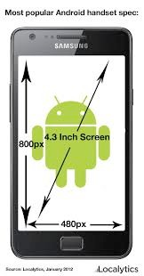

Display size and group
Screen physical size
Diagonal measurement in inches
Devices grouped in 4 generalized sizes
small
normal
large
extra-large

Slide 20
Display Density
Number of pixels per physical area of the screen
Unit of measurement - dpi (dots per inch)
Devices grouped into 6 generalized densities
ldpi: devices from 0 to 120 dpi
mdpi: devices from 121 to 160 dpi
…
Get screen size and density value, and size in dps:
Group | Name | Density
ldpi | low density | 120 dpi
mdpi | medium density | 160 dpi
high | high density | 240 dpi
xhdpi | extra high density | 320 dpi
xxhdpi | extra extra high density | 480 dpi
xxxhdpi | extra extra extra high density | 640 dpi
DisplayMetrics dm = getResources().getDisplayMetrics(); int width = dm.widthPixels; int height = dm.heightPixels;
int densityDpi = dm.densityDpi;
int width_dp = (width / densityDpi) * 160; int height_dp = (height / densityDpi) * 160;

Slide 21
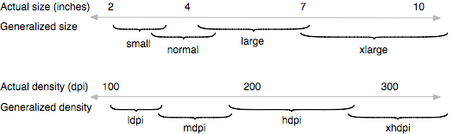
Dimension and Density
Base configuration (normal size and medium density)
First android device, T-Mobile G1
HVGA screen (3.2 inches, 320x480 pixels, 180 dpi)

Slide 22
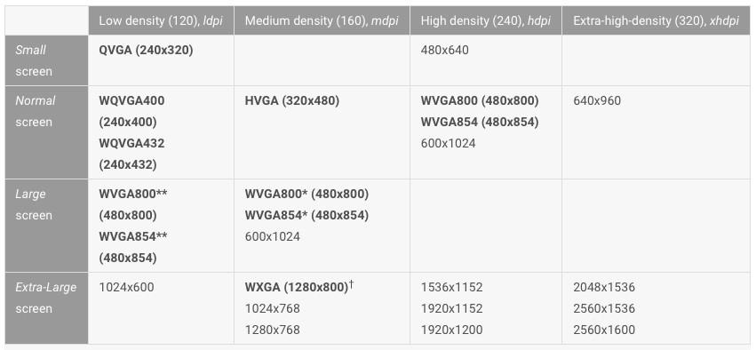
Representative Screens
The bold settings are available through the emulator
* - set 120 dpi density
** - set 160 dpi density

Slide 23
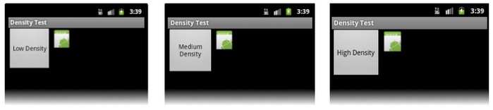
Resolution (Dimension in pixels)
Total number of pixels on the screen
To support multiple screens, applications should not handle pixel dimensions
Problem
The same number of pixels on screens of different sizes produce different densities

Slide 24
Resolution and Screen Sizes: Solution
Dimension values of layout elements in "dp" or with "wrap_content“
Alternative images must be created for different densities
Applications should use screen size and density as defined in generalized groups

Slide 25
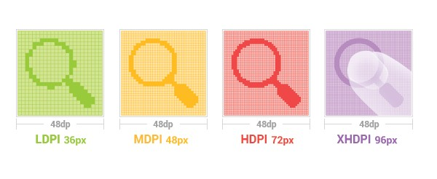
Density-Independent Pixel
Density-Independent Pixel (dp)
Virtual pixel units that must be used to define layouts (positions and dimensions) independently of the density
1 dp = 1 px (pixel on the 160 dpi screen)
px = dp * (dpi / 160)

Slide 26
Scale-Independent Pixel
Scale-Independent Pixel (sp)
dp = px * ratio
ratio = 160 / dpi
sp = dp * scale
sp = px * ratio * scale
Scale refers to text font size (size assigned by the user)
Must be used to set the text size

Slide 27
How to Support Multiple Screens?
Explicitly declare in Manifest the sizes of the supported screens
<supports-screens>
Provide different layouts for different screen sizes
layout-xlarge/
Provide different images for different screen densities
drawable-hdpi/

Slide 28
Multiple screen: 1 - Manifest Declaration
Supported screen sizes declared in Manifest file
When the screen size is larger than the size and smaller than the smallest size allowed the Android system uses the compatible screen mode (scale the baseline).
Bold mean default values. The last three elements were introduced in version 13 (Android 3.2) and should be used instead of the first four ones
<supports-screens
android:smallScreens=["true" | "false"]
android:normalScreens=["true" | "false"] android:largeScreens=["true" | "false"] android:xlargeScreens=["true" | "false"] android:anyDensity=["true" | "false"]
android:requiresSmallestWidthDp="integer" android:compatibleWidthLimitDp="integer" android:largestWidthLimitDp="integer"/>

Slide 29
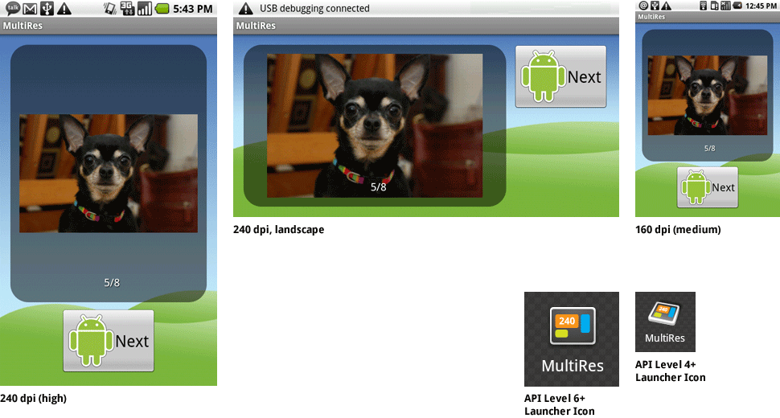
Multiple screens: 2 - Diferent Layouts
Create a layout (xml file) for each screen size and landscape
content_main.xml
Each layout should be placed on a different alternative directory
res/layout-<screen_size>
res/
layout/ # default (portrait)
content_main.xml
layout-land/ # landscape
content_main.xml
layout-large/ # large (portrait)
content_main.xml
layout-large-land/ # large landscape
content_main.xml

Slide 30
Multiple screens: 2 - Diferent Layouts, Display dimensions
Screen physical size
Diagonal measurement in inches
Android grouped in 4 generalized sizes
small
normal
large
extra-large

Slide 31
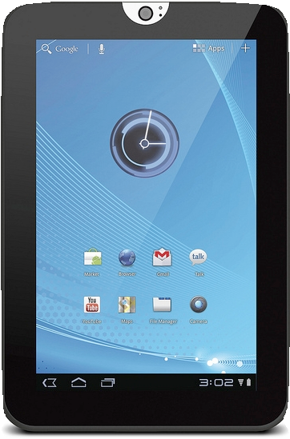
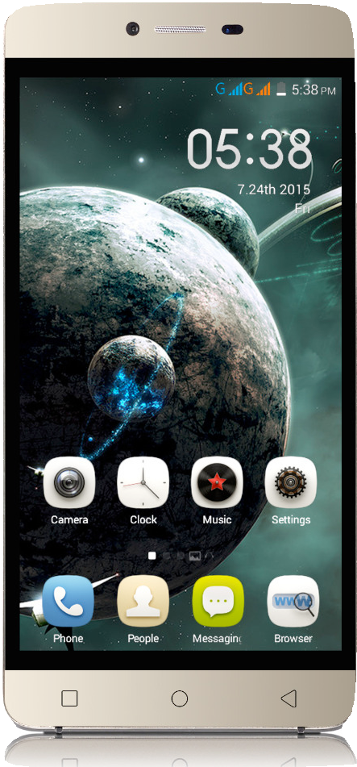
Multiple screens: 2 - Different Layouts: Problem
Smartphone 5” (16:9) and Tablet 7” (4:3)
Same generalized group (large group) but on Tablet have more space
Android 3.2 to Android 7.0
Method based on the width and/or height of the layout defined in dp
res/layout/content_main.xml # Smartphone
res/layout-sw600dp/content_main.xml # Tablet

Slide 32
Multiple screens: 2 - Diferent Layouts
Different Layouts: Android 3.2 to Android 6.0
Examples
res/
layout/content_activity.xml # smartphone (smaller than 600dp available width)
layout-sw600dp/content_activity.xml # tablets 7” (600dp min. to the smallest dimension)
layout-sw720dp/main_activity.xml # tablets 10” (720dp min. to the smallest dimension)
layout-w600dp/main_activity.xml # Multi-pane (720dp min. for width)
layout-h720dp/main_activity.xml # 720dp minimum for height)

Slide 33
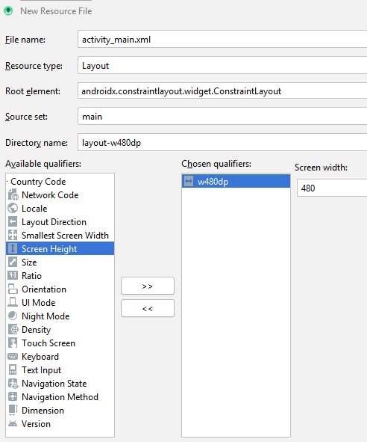
Multiple screens: 2 - Diferent Layouts, Typical Screen
Screen Width | Settings
320 dp | <5” phone (240x320 ldpi, 320x480 mdpi, 480x800 hdpi, …)
480 dp | 5” phone (480x800 mdpi)
600 dp | 7” tablet (600x1024 mdpi)
720 dp | 10” tablet (720x1280 mdpi, 800x1280 mdpi,…)
Add a alternative layout in Android Studio
Over Res/ directory with mouse select New – Android Resource File
In Resource type select the resource type:
Layout, in this case
Select the desired qualifiers and values:
Screen Width with 480dp in figure case
https://developer.android.com/training/multiscreen/screensizes

Slide 34
Multiple screens: 2 - Diferent Layouts, summary
When should we create alternative layouts?
The application does not fit well with small screens
Not optimized to take advantage of additional space on large screens
Not optimized for both orientation (landscape and portrait)

Slide 35
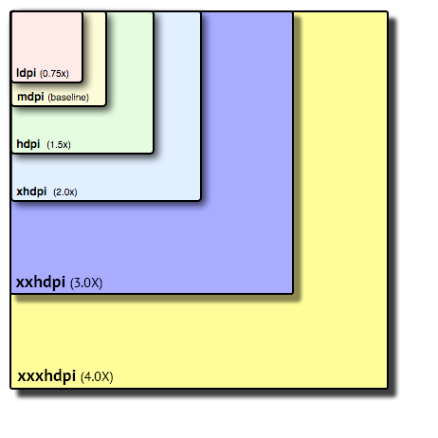
Multiple screens: 3 – Alternative images
Create alternative images for the 6 generalized densities, maintaining the relation between the scales. Example with an image with (pixels):
36x36 - ldpi
48x48 - mdpi
72x72 - hdpi
96x96 - xdpi
180x180 - xxdpi
192x192 - xxxdpi
For all (app) images
Background images, menu icons, status bar icons, application icon

Slide 36
Multiple screens: 3 – Alternative images, organization
Image resources in directories -xhdpi, -hdpi, …
Examples with an Image and Application icon
Image
Application icon
res/drawable-xhdpi/
awesomeimage.png
res/drawable-hdpi/
awesomeimage.png
res/drawable-mdpi/
awesomeimage.png
res/drawable-ldpi/
awesomeimage.png
res/mipmap-ldpi/
finished_launcher_asset.png res/mipmap-mdpi/
finished_launcher_asset.png res/mipmap-hdpi/
finished_launcher_asset.png
. . .

Slide 37
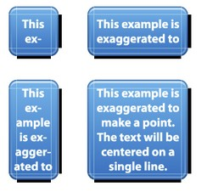
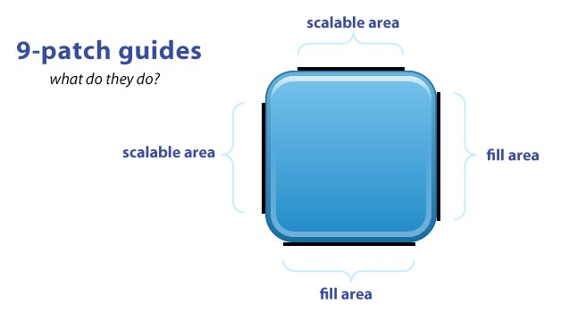
Multiple screens: 3 – Alternative images, 9-Patch Images
9-Patch Images (ficheiros .9.png)
Allows you to scale without distortion
They have defined regions that can be stretched/shrunk and those that remain
Created using the draw9patch tool (Android SDK)
They should be used in the background images of the buttons

Slide 38
Multiple screens: 3 – Alternative images, Best Practices
Use wrap_content, match_parent, or dp units in layout element dimensions
Do not use pixel values in the application
Use ConstrainLayout
Use (percentual) GuideLines; use dimensions set to 0dp to stretch
Do not use the AbsoluteLayout element,
Create alternative images for different screen densities

Slide 39
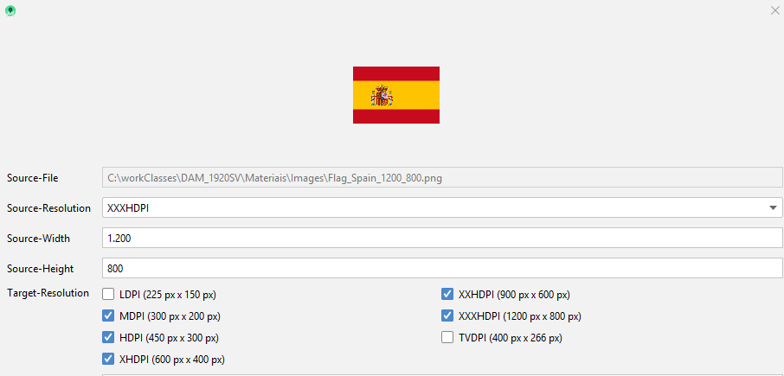
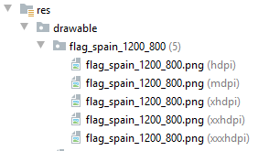
Android Studio automatic creation of alternative images
Use Andriod Drawable Importer plugin
Video: https://www.youtube.com/watch?v=bbFLDR6X2D8
However the plugin in Android plugin repositor it is not working
https://plugins.jetbrains.com/plugin/7658-android-drawable-importer
But we can install this zip as a local file
File -> Settings -> Plugins:: in choose Install Plugin from disk… Browse for zip file, install it and restart Android Studio (wait for a long restart).
Direct link: https://gpskaihu.nz/ADI-hack/ADI-hack-plugin-AS36.zip
To use it: over \res folder choose New -> Batch Drawable Import

Slide 40
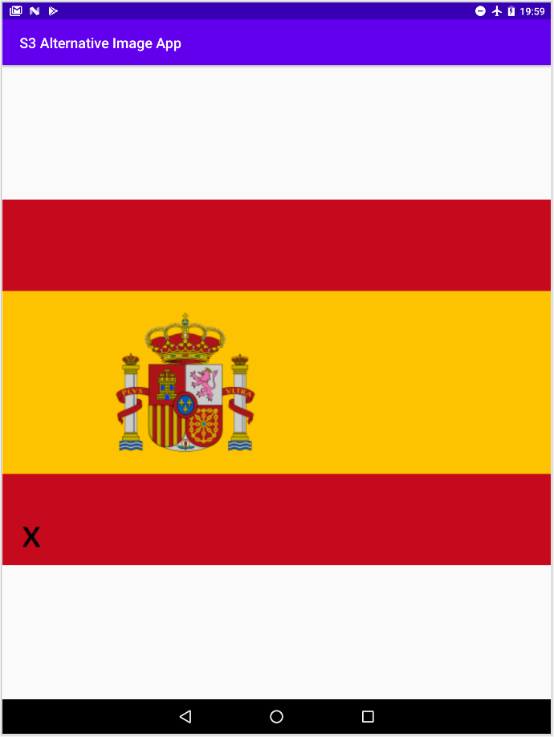
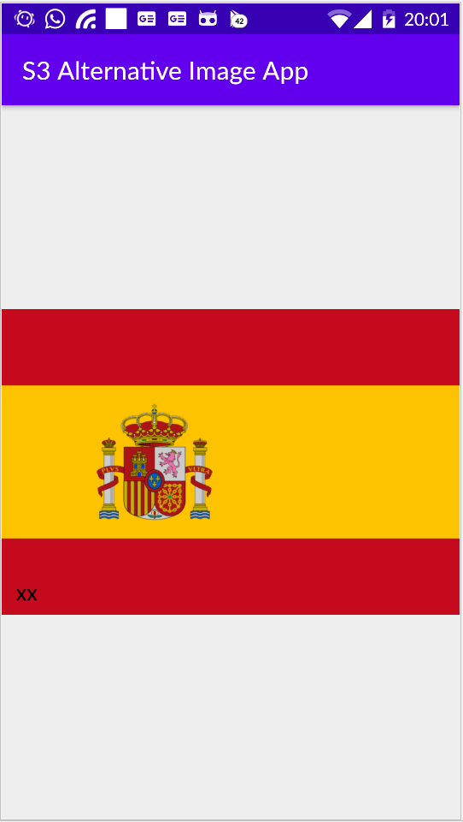
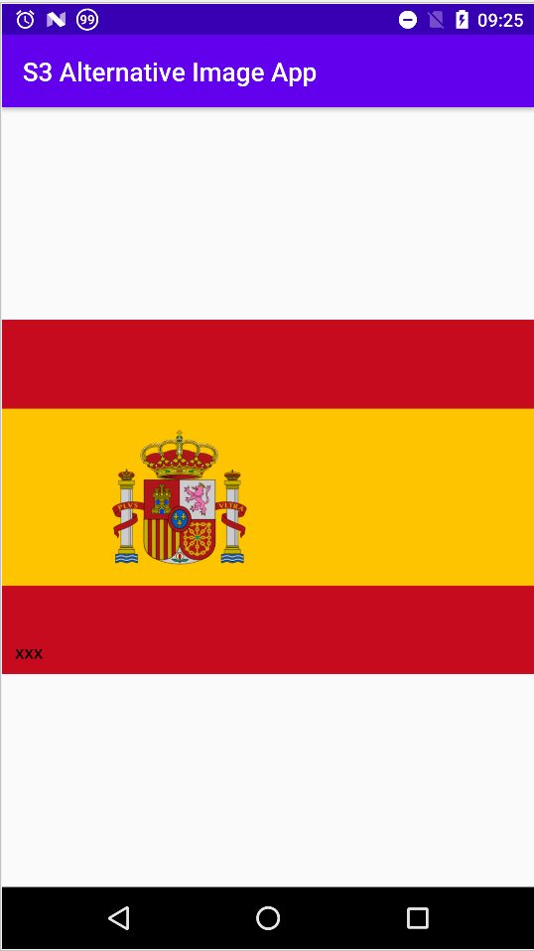
Seeing alternative images
Na app with just one ImageView with the imported image
layout_width and height of 0dp (match constraints) and scaleType fitCenter
Images with an added identifier (l, m, h, x, xx, xxx)
Nexus 9
OnePlus One
Nexus 6

Slide 41
Bibliography
Different Languages
Multiple Screens
Draw9patch
Density-independent Pixels
Alternative Resources
Image Asset Studio
Device Metrics

